Slide 1

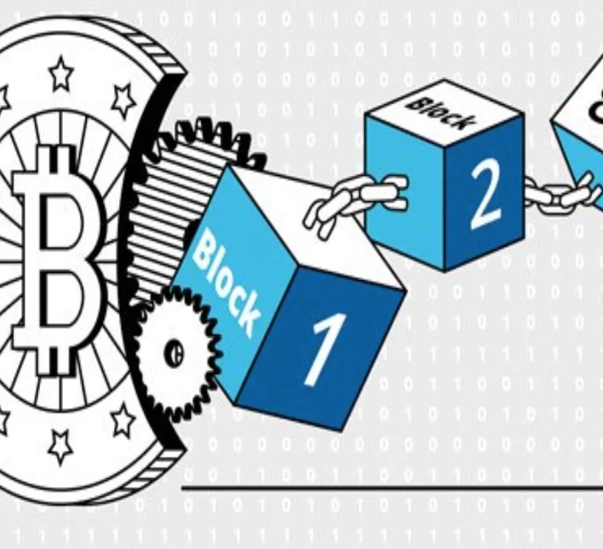
Information reliability in estimate process: a novel proposed blockchain model
Inés Borunda¹, Iván Pérez¹, Erwin Martínez¹, Alberto Ochoa-Zezzatti¹
¹Doctorado en Tecnología, Autonomous University of Ciudad Juárez

Slide 2
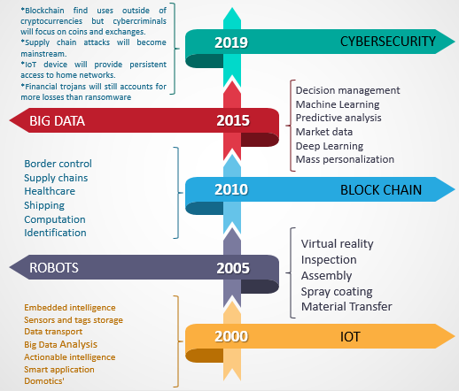
State of the art: Timeline
Abeyratne & Monfared (2016).
Bocek, T., & Stiller, B. (2018).
Barroco, F. (2012): “Que es el Big Data”
C. Pincheira, M., Salek Ali, M., Vecchio, M., & Giaffreda, R. (2018).
Christidis, K., & Devetsikiotis, M. (2016).
D. Meijer and R. W. Carlo, (2016). ‘‘The UK and blockchain technology: A bal-anced approach,’’ J. Payments Strategy Syst., vol. 9.
Evans, D. (2011): “Internet of Things: la próxima evolución de Internet lo está cambiando todo: Cisco
*Juste, M. (2016): “Los ciberataques causaron pérdidas por mas de 350.000 millones en 2015”
This study is based on the implementation of the “Blockchain in the process of the “recuse for quote” process that feeds the system of estimates for the quotation of new products, or changes to existing ones, used by automotive companies.

Slide 3
Blockchain
By 2020, it is estimated that 60% of the leading manufacturers will depend on digital platforms, which will be responsible for supporting the functions that are responsible for 30% of their revenues. By 2021, the range of new technologies will be integrated into the manufacturing sector, with 20% of the leading manufacturers depending on some combination of artificial intelligence, internet of things; cognitive systems and blockchain (Mire, 2018).
That’s why achieving transparency requires accurate and secure data collection in the storage of these, a difficult task that is currently entrusted to third parties through centralized information repositories (Abeyratne and Monfared, 2016).
Therefore, it is extremely important to take into account that sectors such as: health, insurance, government and supply chain management are likely to be transformed by the blockchain (Kshetri, 2018).

Slide 4
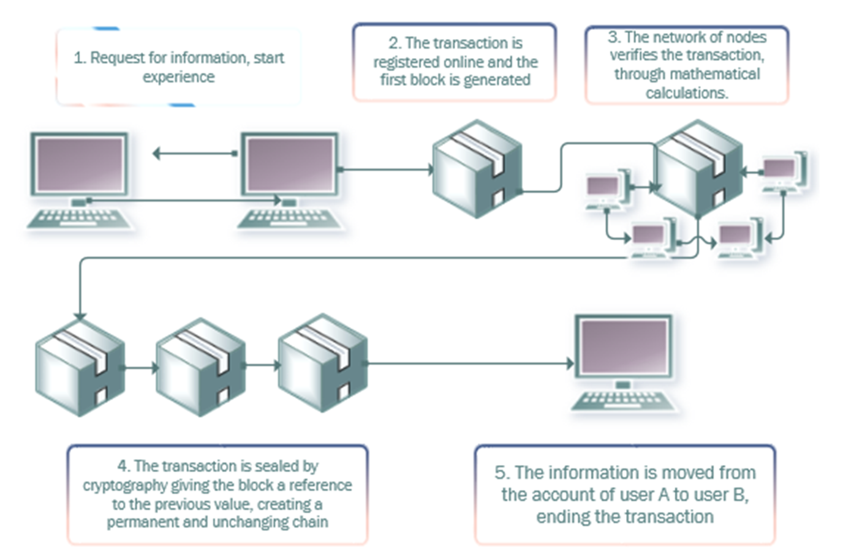
Fig. 1 Information transfer by using blockchain

Slide 5



Blockchain
Meijer and Carlo (2016) discussed the value of the blockchain application in the smart contract.
Yang and Pan (2016) proposed blockchain applications to influence laws and regulations.
Wang (2018) built the data of the shared security network system.
However, blockchain has not been detected in the handling of customer-supplier information regarding the "recuse for quotes" used to quote estimates

Slide 6
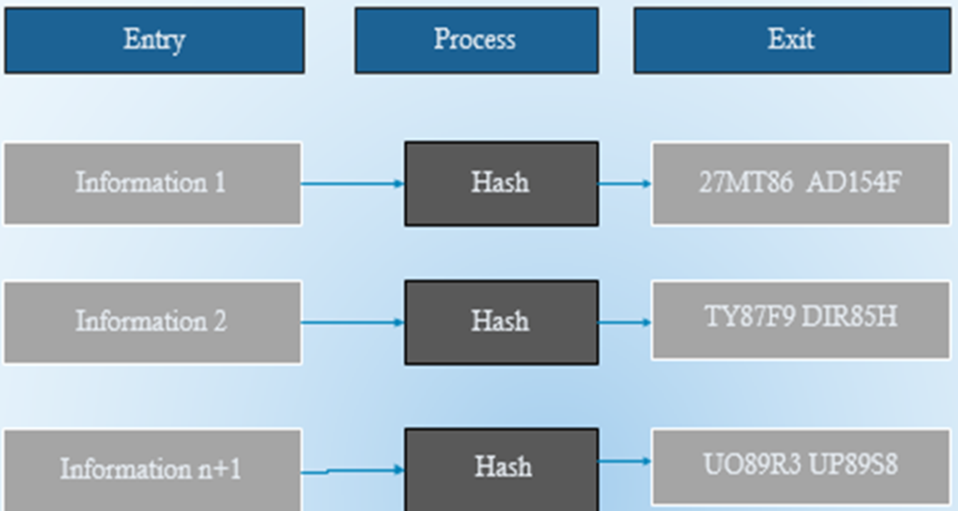
Hash Function
Fig. 2. Hash Function

Slide 7
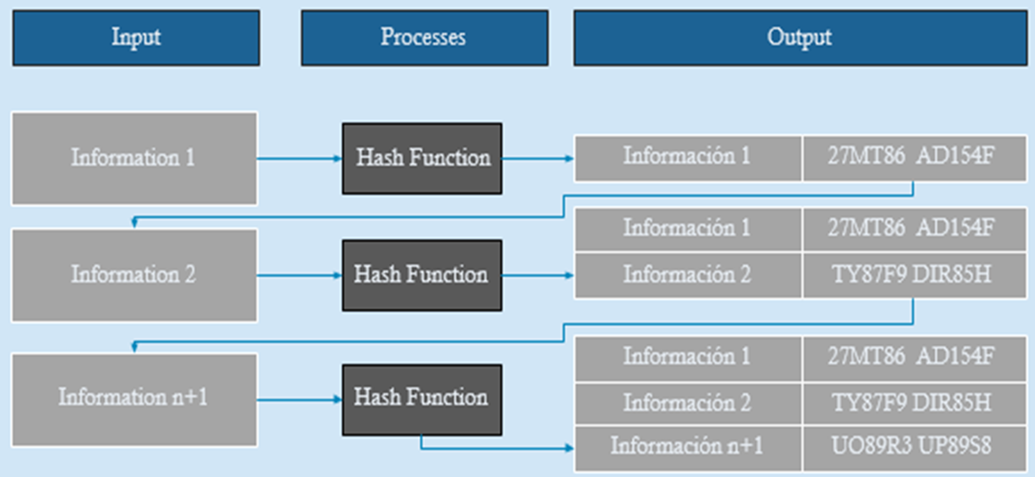
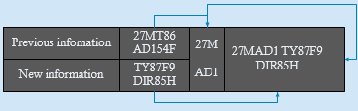
Hash Function Proposal
Fig. 3. Incorporation of several processes in the information network chain, using blockchain

Slide 8
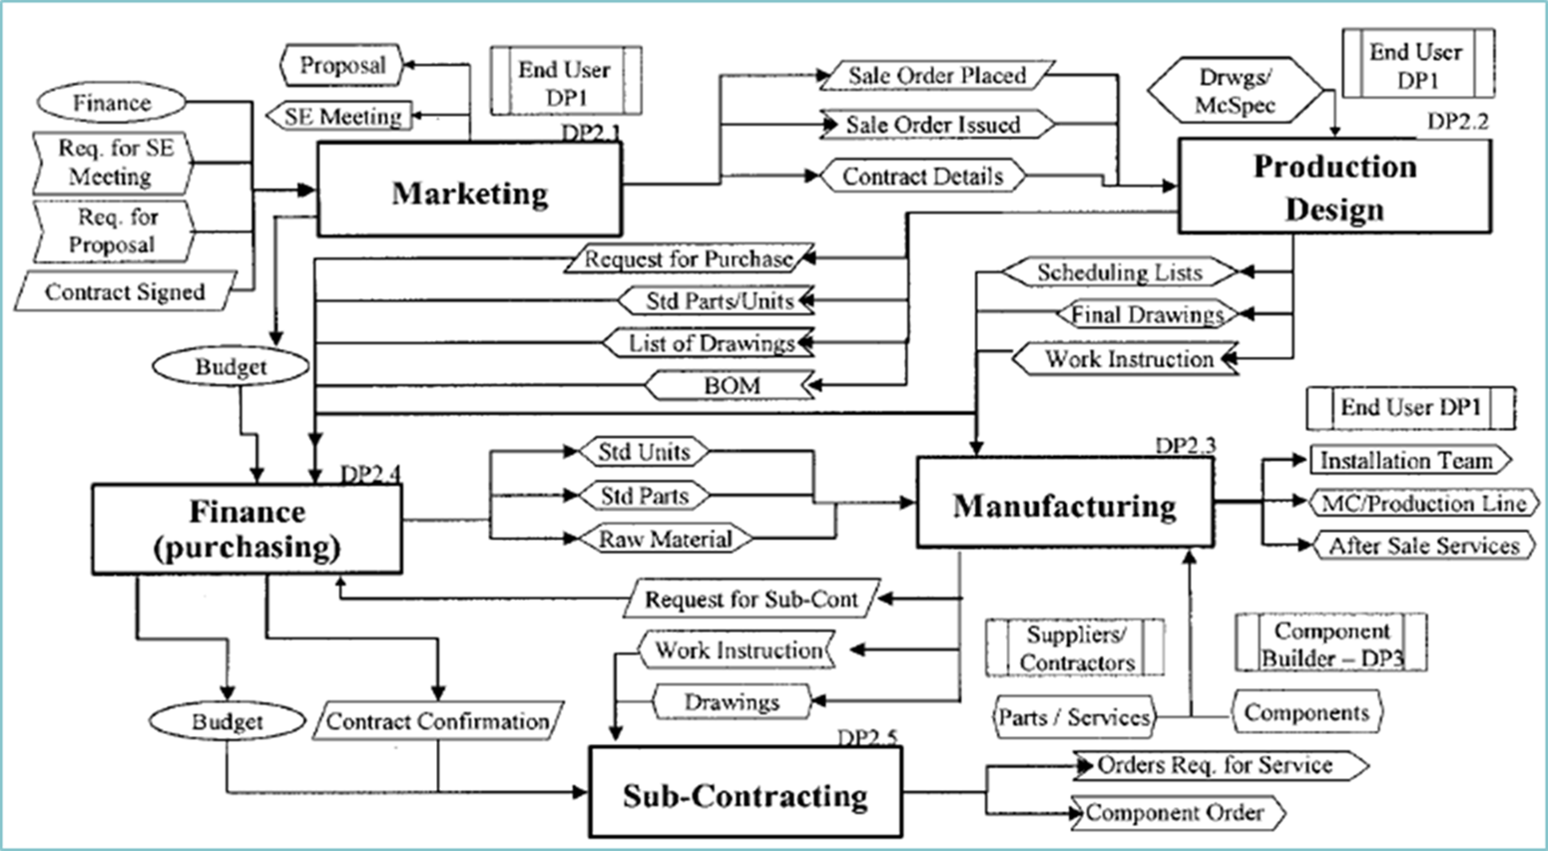
Fig. 4 Interaction diagramfrom the perspective of the machine builder partner in the production and assembly machine domain by R P Monfared, A A West, R Harrison and R H Weston MSI Research Institute, Loughborough University, Loughborough, Leicestershine, UK

Slide 9
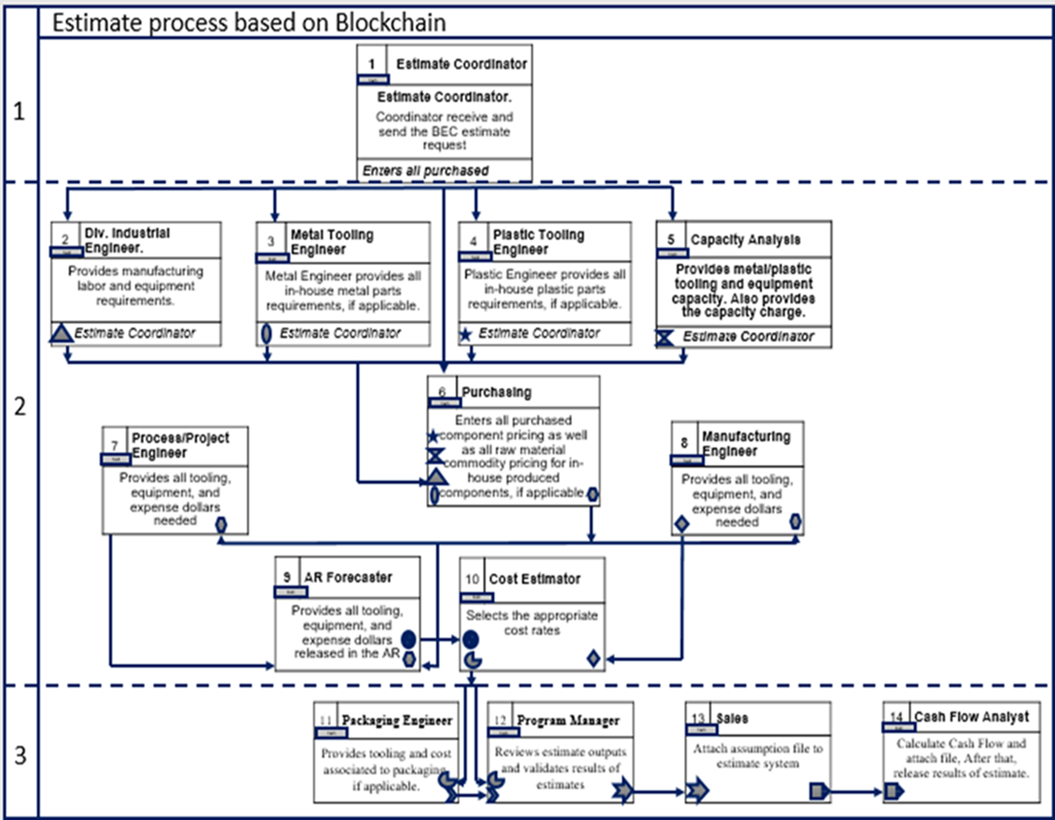
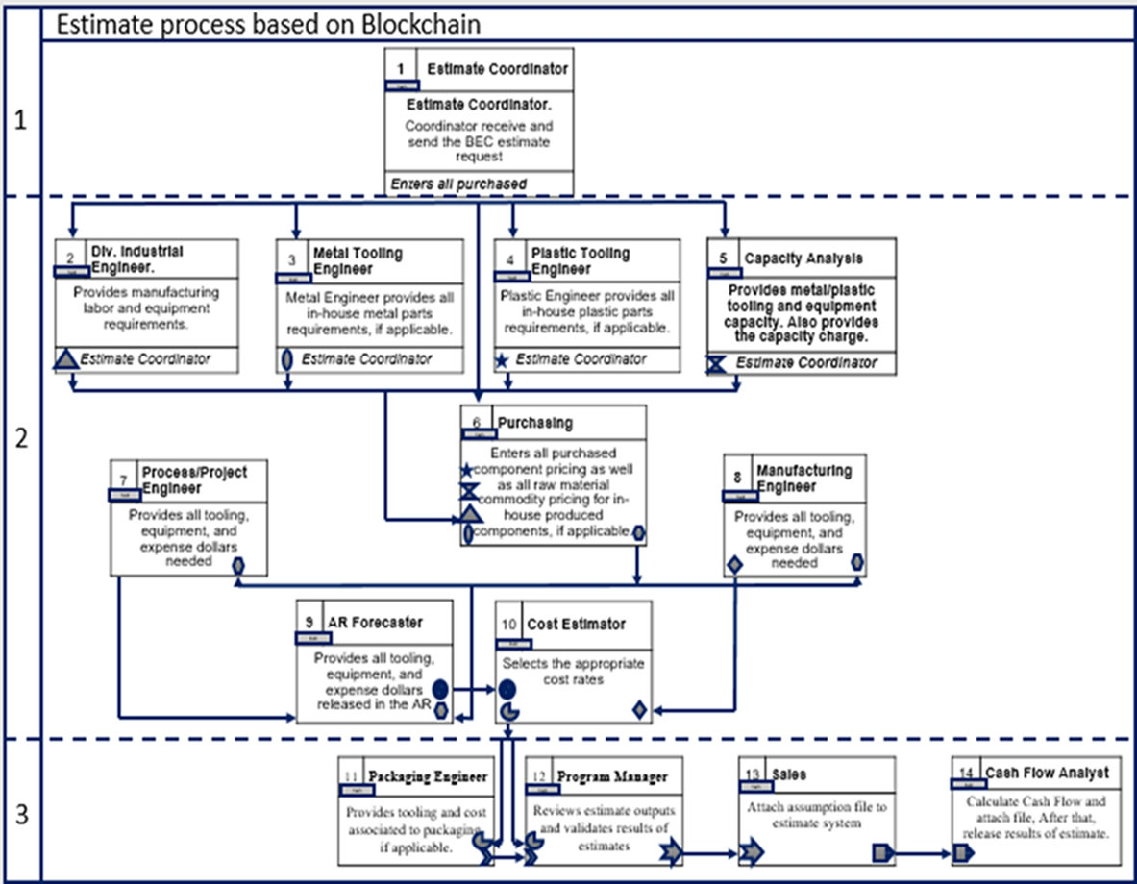
Figure. 5. Estimate process based on Blockchain

Slide 10
In a centralized system, the administrator could be bribed, and the entire system could be subject to manipulation and falsification of information (Tian, 2017).
With the structure of the blockchain this risk is avoided

Slide 11
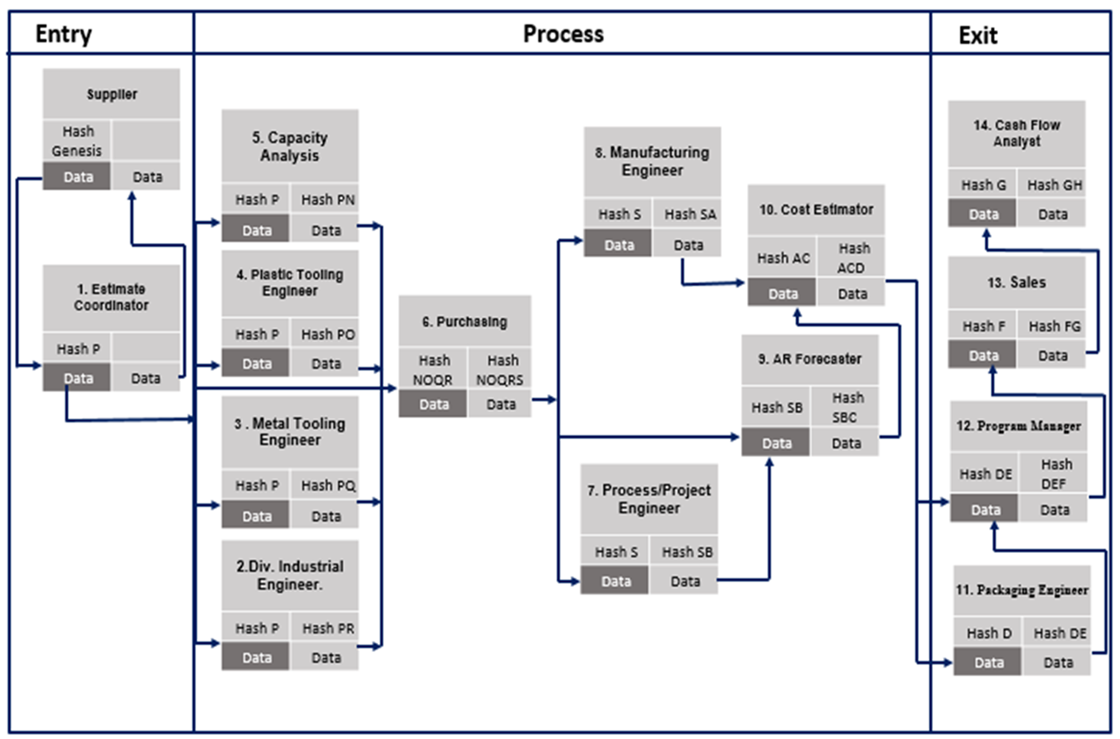
Figure 6. Model for the Estimate process based on Blockchain

Slide 12
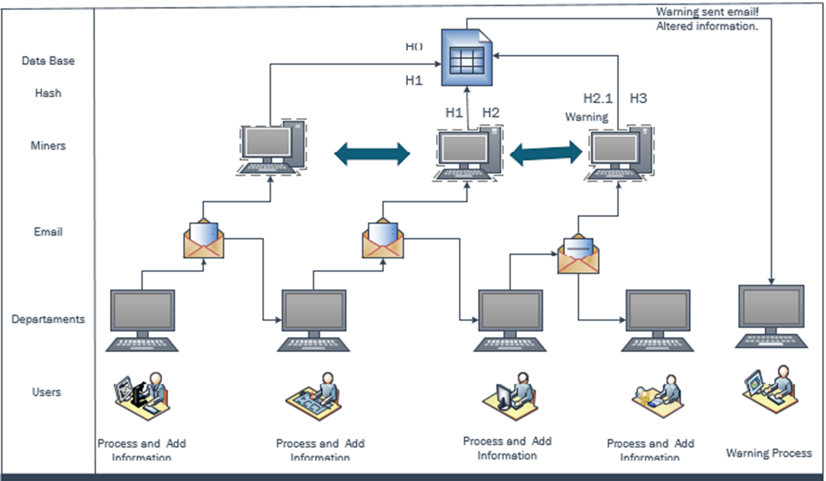
Figure 7. Model for the Estimate process based on Blockchain

Slide 13
References
*C. Pincheira, M., Salek Ali, M., Vecchio, M., & Giaffreda, R. (2018). Blockchain-based traceability in agri-food supply chain management: A practical implementation. In IoT vertical and topical summit on agriculture-tuscany, Tuscany
* Christidis, K., & Devetsikiotis, M. (2016). Blockchains and smart contracts for the internet of things. IEEE
*Cruz-Zapata, Belén; Fernández-alemán, José-Luis; Toval, Ambrosio (2015). “Security in cloud computing: A mapping study”. Computer science and information systems, v. 12, n. 1, pp. 161-184.
* D. Meijer and R. W. Carlo, (2016). ‘‘The UK and blockchain technology: A balanced approach,’’ J. Payments Strategy Syst., vol. 9
* D. Pierro, M. (2017). What is the blockchain? Computing in Science & Engineering
*Rantos, Konstantinos; Fysarakis, Konstantinos; Manifavas, Charalampos (2012). “How effective is your security awareness program? An evaluation methodology”. Information security journal: A global perspective, v. 21, n. 6, pp. 328- 345.
*Sabo, F. (2015). “Industry 4.0 -A Comparison of the status in Europe and the USA”
*Sánchez, A. (2016). “El Internet de las Cosas, tsunami tecnológico y revolución digital”.
*Sindhuja, P. N. (2014). Impact of information security initiatives on supply chain performance. Information Management & Computer Security, 22(5), 450-473.
*Spears, J. L. y Barki, H. (2010). User participation in information systems security risk management. MIS Quarterly, 34(3),503-522.
* Abeyratne, S., & Monfared, R. (2016). Blockchain ready manufacturing supply chain using distributed ledger. International Journal of Research in Engineering and Technology.
*Aimeur, Esma; Schoenfeld, David (2011). “The ultimate invasion of privacy: identity theft”. In: 9th Annual into conf on privacy, security and trust, pp. 24-31.
*Andelfinger, V. & Hänisch, T. (2015). Internet der Dinge. In Andelfinger, V. & Hänisch, T. (Eds.), Wiesbaden: Springer Fachmedien Wiesbaden
*Aurigemma, Salvatore; Panko, Raymond (2012). “A composite framework for behavioral compliance with information security policies”.
*Arrieta, E. (2015): “Porque la fabricación 3D cambiara el mundo”
*Asare, P. et al. (2012). Cyber-Physical Systems - a Concept Map. Online [May 2016].
*Bach, T. (2008). DSL versus Kabel: Information sexternalitäten also Determinates von. Online [Jul 2016].
* Barki, H. y Hartwick, J. (2001). Interpersonal conflict and its management in information system development. MIS Quarterly, 25(2), 195-228.
*Bauernhansl, T. (2014). Die vierte industrielle Revolution - Der Weg in in wertschaffendes Produktion paradigm. In Industry 4.0 in Produktion, Automatisierung und Logistik (pp. 5– 35).
*Beorkrem, C. (2012). Material Strategies in Digital Fabrication. Ed. Routledge. Londres
* Bocek, T., & Stiller, B. (2018). Smart contracts-blockchains in the wings. Digital marketplaces unleashed (pp. 169–184). Berlin, Heidelberg: Springer
*Cruz, M. Oliente, P. Morales, C. González, C. Cendon, By Hernández, A. (2015). “Las tecnologías IoT dentro de la industria conectada 4.0”
[.

Slide 14

Information reliability in estimate process: a novel proposed blockchain model
Inés Borunda¹, Iván Pérez¹, Erwin Martínez¹, Alberto Ochoa-Zezzatti¹
¹Doctorado en Tecnología, Autonomous University of Ciudad Juárez

