Slide 1
Disease Prediction Applying Machine Learning
By.
Robles Ontiveros Carlos Daniel

Slide 2
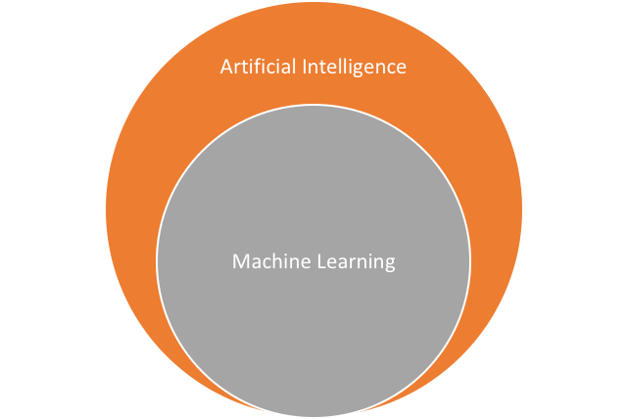
AI and Machine Learning
Technique that combines a set of algorithms with the purpose of training machines.
Among the machine learning algorithms it is possible to find:
Decision threes
Naive Bayes
Logistic regression
K-means algorithm
Linear discriminant analisis
Support Vector Machines

Slide 3
Last years
Machine learning has been applied with the objective of predicting scenarios in:
health
banking
Financial
Educational

Slide 4
Two Predictive Scenarios
Our Research
Breast Cancer
Diabetes

Slide 5
We worked with two datasets each obtained from open internet sources
BREAST CANCER
Data: Hospitals of the University of Wisconsin, Madison, of Dr. William H. Wolberg
DIABETES
Data: National Institute of Diabetes and Digestive and Kidney Diseases

Slide 6
596 records of which 212 a malignant tumor was detected
Breast Cancer
2nd cause of death in a woman!

Slide 7
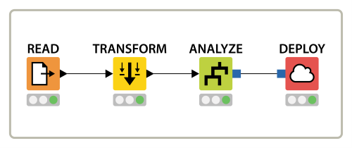
Variables to take into account
Tumor radius
Size of the perimeter of the tumor.
Size of the tumor area.
Average variation in radio lengths.

Slide 8
Results
Id | Radius (mm) | Average of the 𝜎 of the gray scale.(mm) | Perimeter (mm) | Área (${mm}^{2}$) | Average radius length variation(mm) | Diagnostic prediction | Diagnostic
1 | 17.99 | 10.38 | 122.8 | 1001 | 0.1184 | 20% | Maligno
2 | 20.57 | 17.77 | 132.9 | 1326 | 0.08474 | 32% | Maligno
3 | 19.69 | 21.25 | 130 | 1203 | 0.1096 | 1% | Maligno
4 | 11.42 | 20.38 | 77.58 | 386.1 | 0.1425 | 38% | Maligno
5 | 20.29 | 14.34 | 135.1 | 1297 | 0.1003 | 20% | Maligno
20 | 13.54 | 14.36 | 87.46 | 566.3 | 0.09779 | 77% | Benigno
21 | 13.08 | 15.71 | 85.63 | 520 | 0.1075 | 67% | Benigno
22 | 9.504 | 12.44 | 60.34 | 273.9 | 0.1024 | 120% | Benigno
49 | 12.05 | 14.63 | 78.04 | 449.3 | 0.1031 | 86% | Benigno
50 | 13.49 | 22.3 | 86.91 | 561 | 0.08752 | 67% | Benigno

Slide 9
Graphics

Slide 10
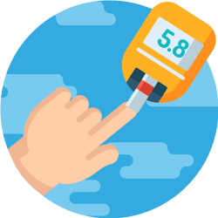
Diabetes
Study population:
768 people: This study was conducted only for women of the original Pima group of at least 21 years.

Slide 11
Variables to take into account
Number of times pregnant
Plasma glucose concentration at 2 hours in an oral glucose tolerance test
Diastolic blood pressure (mm Hg)
Thickness of the triceps skin fold (mm)
2-hour serum insulin (mu U / ml)
Body mass index
Pedigree function of diabetes (genetics)
Age (years)

Slide 12
Results
ID | Pregnancies | Plasma | Blood pressure | Skin thickness | Insulin | Body mass |  | Age | Prediction | Class
1 | 6 | 148 | 72 | 35 | 0 | 33.6 | 0.627 | 50 | 0.65175729 | 1
2 | 1 | 85 | 66 | 29 | 0 | 26.6 | 0.351 | 31 | 0.00573265 | 0
3 | 8 | 183 | 64 | 0 | 0 | 23.3 | 0.672 | 32 | 0.73642449 | 1
4 | 1 | 89 | 66 | 23 | 94 | 28.1 | 0.167 | 21 | -0.0219232 | 0
5 | 0 | 137 | 40 | 35 | 168 | 43.1 | 2.288 | 33 | 0.83318937 | 1
6 | 5 | 116 | 74 | 0 | 0 | 25.6 | 0.201 | 30 | 0.21054145 | 0
7 | 3 | 78 | 50 | 32 | 88 | 31 | 0.248 | 26 | 0.05736238 | 1
8 | 10 | 115 | 0 | 0 | 0 | 35.3 | 0.134 | 29 | 0.59612039 | 0
9 | 2 | 197 | 70 | 45 | 543 | 30.5 | 0.158 | 53 | 0.66541521 | 1

Slide 13
Test prediction

Slide 14
Thank you very much!
Robles Ontiveros Carlos Daniel
55 1289 0378
carlosdanielroblesontiveros@Gmail.com
Instituto Politécnico Nacional

