Slide 1
Polytechnic University of the State of Morelos
1
Application of Data Mining Techniques and Algorithms for the Detection of Breast Cancer
October, 2019
Eng. Zagal Solano José Enrique

Slide 2
Contents
Introduction
Related Works
Description of the technique
Problem Statement & Analysis of results
Conclusions

Slide 3
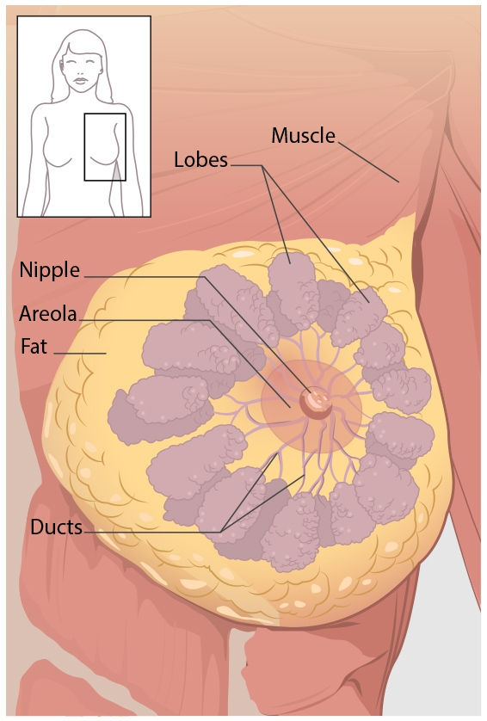
What Is Breast Cancer?
Breast cancer is a disease that affects a large part of world society.
Is disease that mainly affects women.
It is estimated per year 552,000 women died.
The most common form for detection is self-exploration, however this is only detected in more advanced stages.

Slide 4
Cancer Trends in Mexico
In Mexico also since 2006, breast cancer is the leading cause of cancer death in women. An occurrence of 20,444 cases in women is estimated annually, with an incidence of 35.4 cases per 100,000 women. The entities with the highest mortality from breast cancer are Coahuila, Sonora and Nuevo León.

Slide 5
Cancer Trends in Mexico

Slide 6
Tools Used

Slide 7
Data mining for the detection of breast cancer
Data mining allow the evaluation of different models about prevention and diagnosis of breast cancer.
We use DB with patient information to prevent or detect disease. (Institute of Oncology University Medical Center, 11 July 1988)

Slide 8
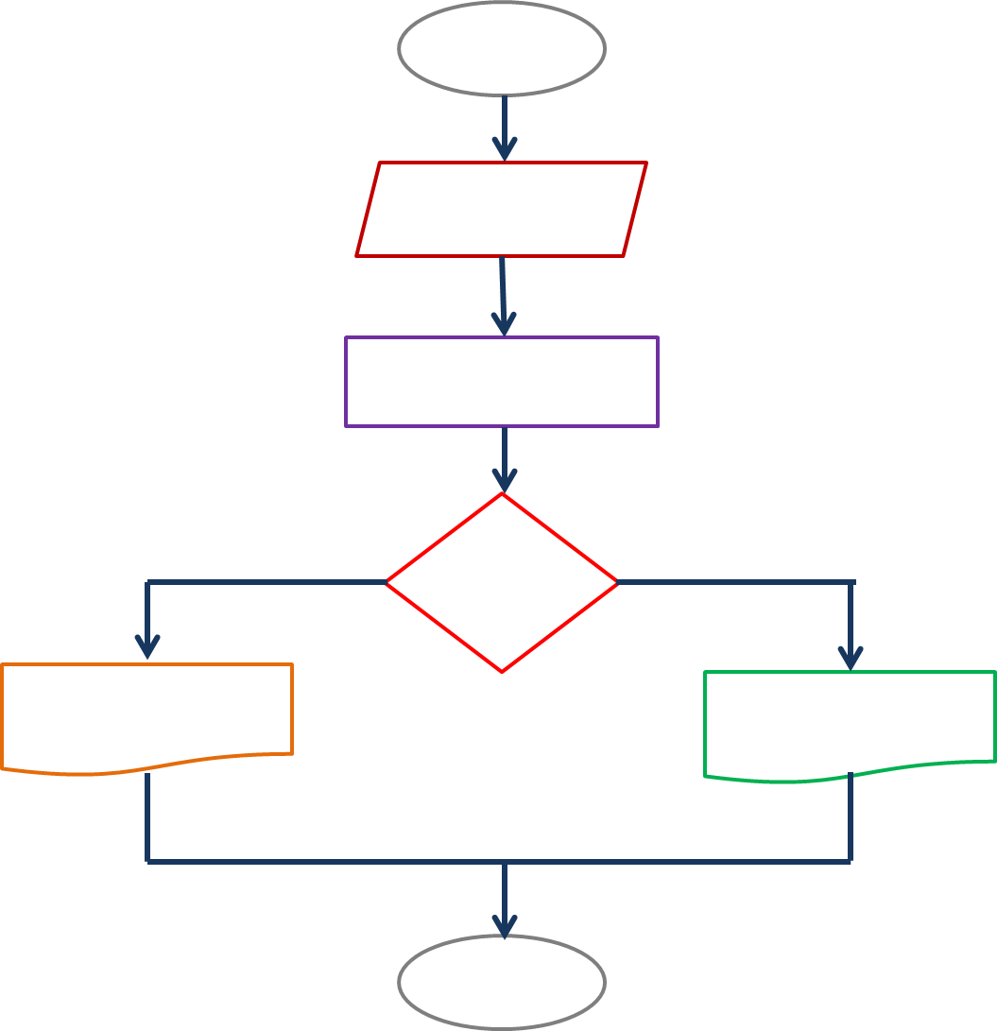
Algorithms Used

Slide 9
K-NN Algorithm
The algorithm is based on the comparison of an unknown example with the training examples k that are the closest neighbors of the unknown example.

Slide 10
Decision Tree
It is a type of supervised learning algorithm (with a predefined target variable) that is used in classification problems and it works for input and output variables both categorical and continuous. They learn and train from given examples and predict for unseen circumstances.

Slide 11
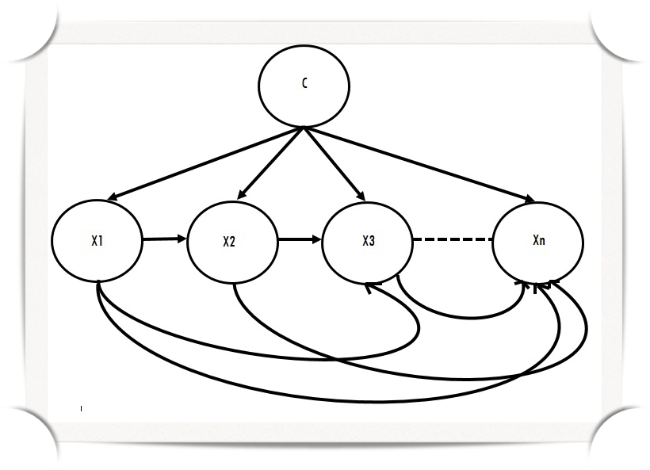
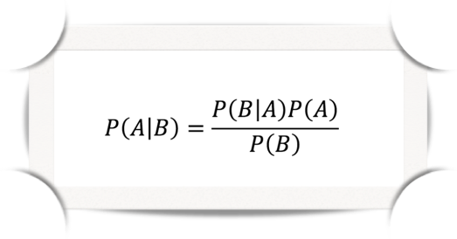
Naive Bayes Classifier
Algorithm based on probabilities conditioned with known data. Its operation is based on calculating probabilities of known data and according to the results and a formula, it can calculate the probability that the entry is of one kind or another. It is based on Bayes Theorem or conditional probability theorem.

Slide 12
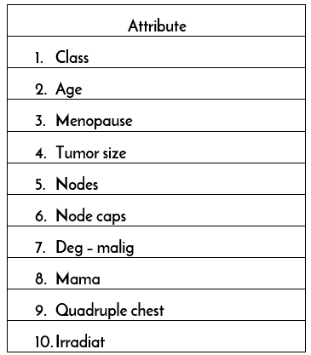
Analysis of results
201 instances of the class: no recurrence
85 instances of the class: recurrence,
Mentioning a range of precision of four systems tested with a result of 68% -73.5%.
Number of Instances: 286

Slide 13
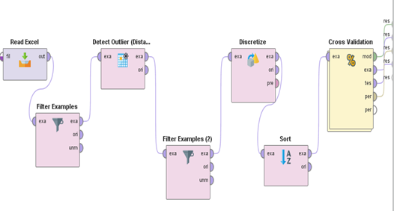
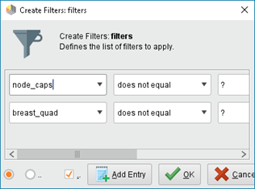
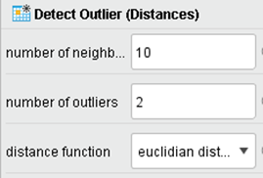
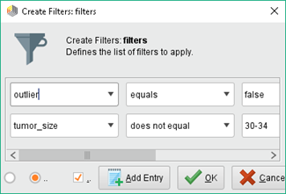
K-NN: Obtained results

Slide 14
K-NN: Obtained results

Slide 15
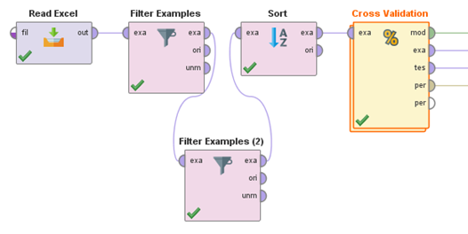
Decision Tree: Obtained results

Slide 16
Decision Tree: Obtained results

Slide 17
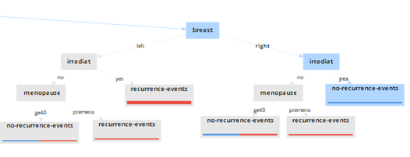
Decision Tree: Obtained results

Slide 18
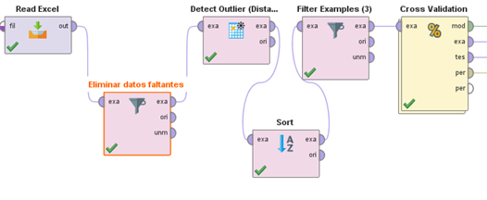
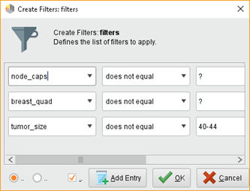
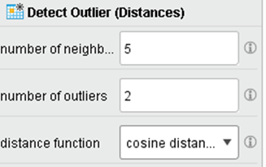
Naive Bayes: Obtained results

Slide 19
Naive Bayes: Obtained results

Slide 20
Conclusions
The development of this research obtained favorable results.
Stating that the data is treated properly and implement a smaller number of data lost in the training process.
Achieving such an in-depth analysis, will allows us in the future, to analyze patterns and obtain a high percentage of prediction in the events of such topics so relevant at present, not ruling out the possibility that, over the years, the algorithms and their set of training data can give solution to outstanding events in society within each of its areas.

Slide 21
References
Salud, S. d. (8 de Septiembre de 2015). Gobierno de México. Obtenido de Programa de Acción Específico Prevención y Control del Cáncer de la Mujer 2013 - 2018: https://www.gob.mx/salud/acciones-y-programas/informacion- estadística
Berástegui Arbeloa, G. (2018). Implementación del algoritmo de los k vecinos más cercanos y estimación del mejor valor local para su cálculo. Pamplona
Gabits. (2 de Diciembre de 2009). Blogspot. Obtenido de Algoritmos de mineria de datos: http://algoritmosmineriadatos.blogspot.com/2009/12/algoritmo-naive-bayes.html
Sloth's Lab. (3 de Diciembre de 2015). Obtenido de http://www.slothslab.com/python/2015/12/03/clasificador- bayesiano-ingenuo-python.html

